Slide 1
Project title Internship Project On Data Wrangling (Project-2) PRESENTED BY MOHAN KUMAR JHA Internship organization Next Hikes IT Solutions Ongoing training on Digi Crome Academy

Slide 2
Project Requirements
Three Datasets are given:
Have to download and read the datasets
The datasets have many ambiguities
Have to apply different data acquisition techniques to remove those ambiguities
Import all the important libraries and use pandas and NumPy libraries as well.
Have to apply the following data acquisition techniques for the datasets:
1. Merge datasets, 2. Identify unique values, 3. Drop unnecessary columns, 4. Check the dimensions of the dataset, 5. Check the datatype of the dataset, 6. Check datatype summary
7. Treat missing values, 8. Validate the correctness of the data at the primary level if applicable
Actual two tasks are required to be performed
Task 1: Data Acquisition and Data Wrangling on dataset 1 and dataset 2
[All methods to be applied for data wrangling concerning the listed above and
Combine data from dataset1 and dataset2, Work on central tendency. ].
Task2: Data Acquisition and Wrangling on Dataset 3.
Concatenate combine_ data with Dataset_3. To be Worked on missing values and
Outliers.
Check the skewness and correlation of the data

Slide 3
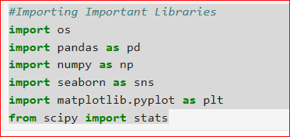
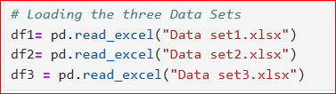
Project Execution
Importing the required libraries
Make sure that the excel files (Data sets-1,2,3) downloaded are in the cwd (Current Working Directory)

Slide 4

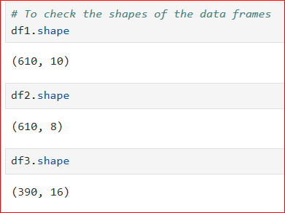





Project Execution
Converted Object Type Date and time data to Datetime64 type
Now Checking the null value in all the Datasets as
Now Checking the info, describe of all the datasets and also converting the categorical value to numerical value for all the datasets as

Slide 5
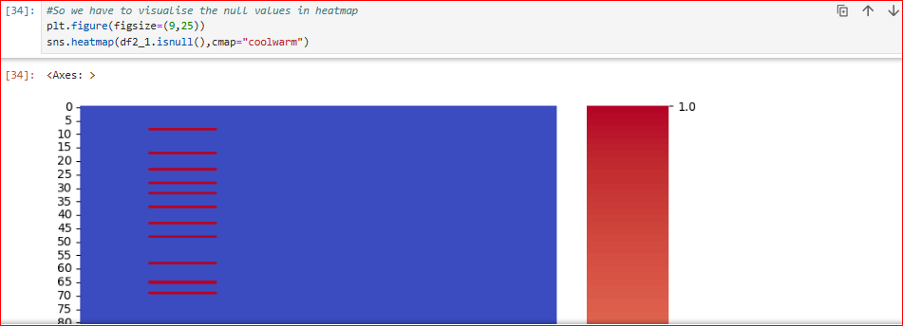
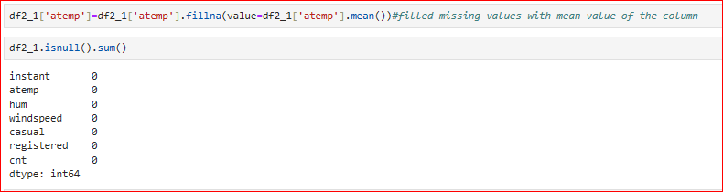
Project Execution
Now we have to fill the null value
with the mean value of the column

Slide 6

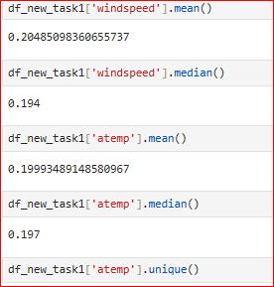
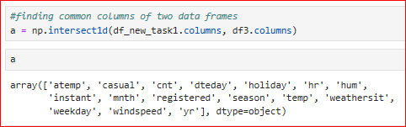

Project Execution
Now we have to merge the data sets as per Task1
Now we have to find the mean,
median and modes and Unique values and common values of the dataframes
Concat Function concatenates the task1 data
Frame with dataframe 3

Slide 7

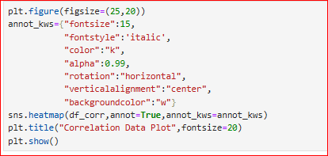
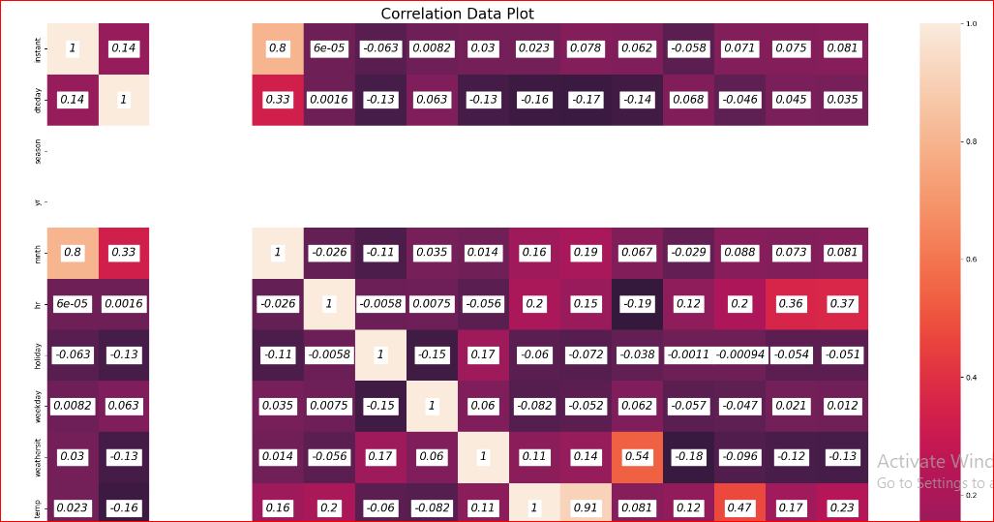
Project Execution
Now we have to Find the Correlation of the new data frames
and visualize the same

Slide 8
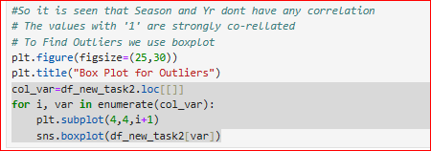
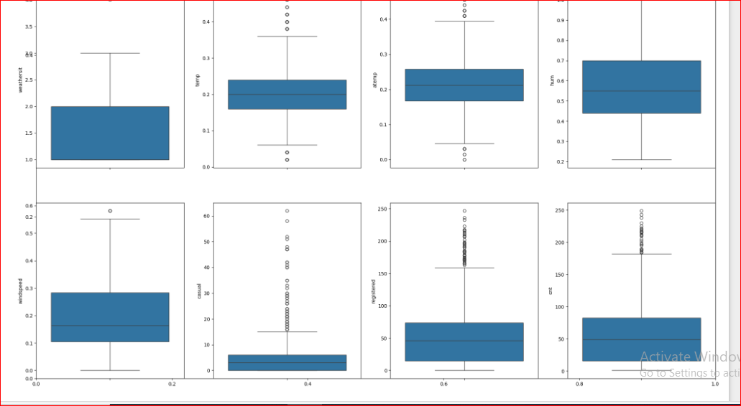
Project Execution
Now we find the outliers using boxplot

Slide 9
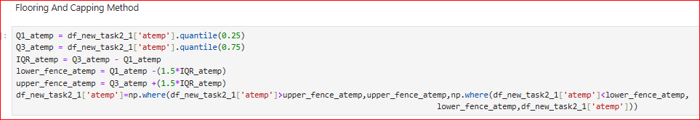
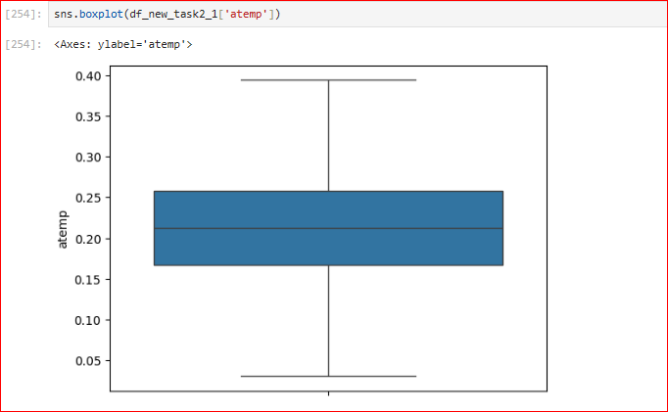
Project Execution
Now we are using the Flooring and capping method for outliers
Similarly find for other features also

Slide 10
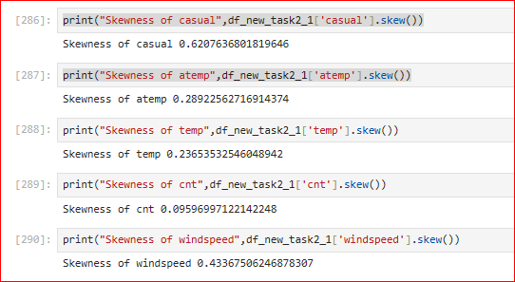
Project Execution
Now have to find out the skewness of the different features

Slide 11
Some Methods and Definations
Learning Outcome:
Technical Skills:
1. Data Acquisition
2. Data Wrangling

Slide 12
Thank You

